Slide 1
Počítačová lingvistika
Recent language models
(LMs)
and their applications

Slide 2
Language model types
Probabilistic models
N-grams (Shannon 1948)
Prob. of a word is determined by N previous words
Were discovered in 1980s, now they are on the decline
LMs based on neural networks
Related concepts
Recurrent neural networks (1982)
Vector representation of words (1986)
LSTM unit (1997)
First NN-based LM was proposed in 2003
Development from 2013 onwards
Together with methods for extraction of word embedding (Word2Vec, Glove, …)

Slide 3
NN-based language models
Recurrent neural networks (2010-2013)
LSTM and GRU
Encoder-decoder architecture (2014)
Attention mechanism
Transformers (2017)
Large pre-trained LMs
BERT (Google, 2018)
ELECTRA (2020)
GPT (OpenAI, 2018)

Slide 4
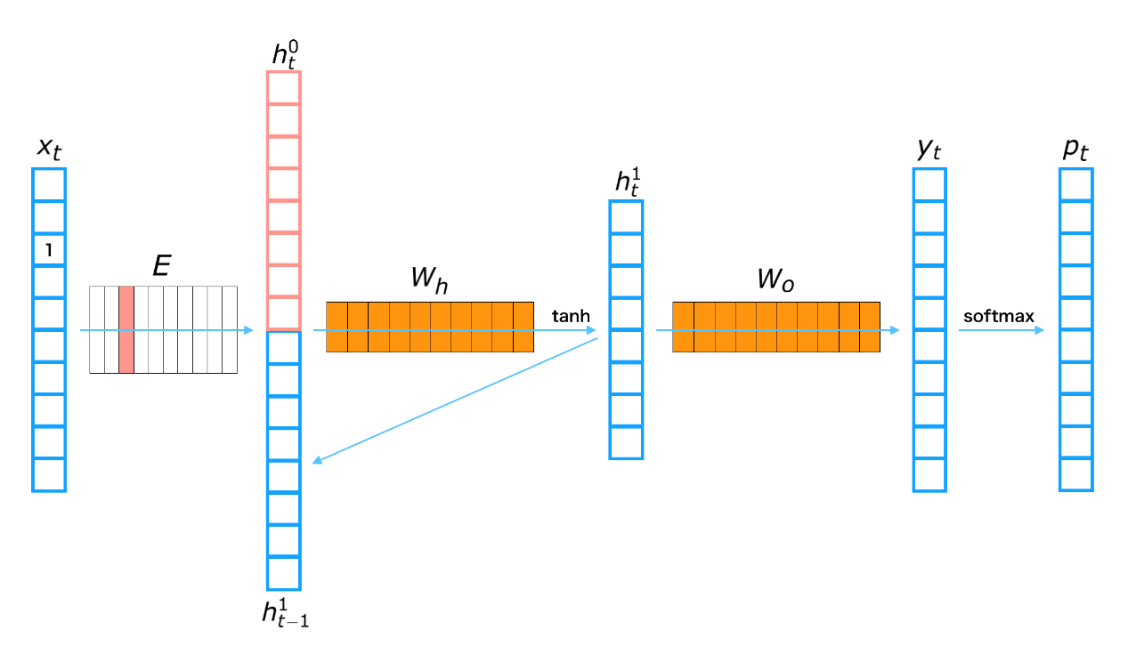
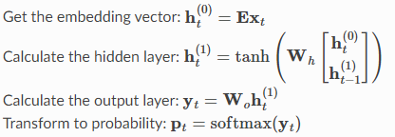
RNN-based LMs
The output probability of the next word is given by
Actual word at the input (by its embedding)
Last value of the hidden vector
Its dimension is >1 for RNNs with multiple units

Slide 5
RNN-based LM: disadvantages
Hard to train (vanishing gradient problem)
traditional activation functions (tanh) have gradients in the range (0,1]
backpropagation computes gradients by the chain rule (using multiplying)
the gradient (error signal) decreases exponentially with the depth of the network
the early layers train very slowly
Poor modelling capability for long-term dependencies

Slide 6
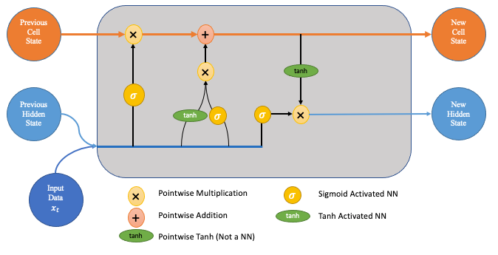
Long Short-Term Memory (LSTM)
The LSTM model can decide whether to retain previous information in short-term memory or discard it.
Improved modelling for long-term dependencies
The output from LSTM depends on
Input vector
Last output (hidden) state vector
Last inner (cell state) vector representing the short-term memory
Cell state vector is controlled by two gates:
These are two NN with different activation functions
They depends on the input vector and last output (hidden state) vector
Similar model with build-in memory is GRU
(Gatted Recurrent Unit)
https://towardsdatascience.com/lstm-networks-a-detailed-explanation-8fae6aefc7f9

Slide 7
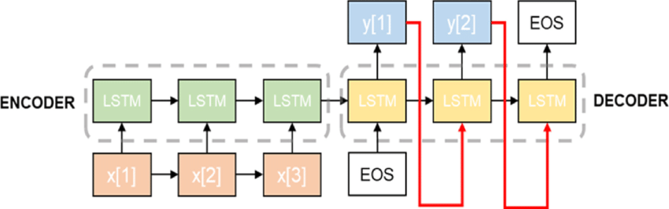
Encoder-Decoder architecture
Allows for N:M seq2seq learning
input and output sequences can have varying length (machine translation)
Still limited capability for modelling of long-term dependencies
The input to the decoder is formed just by single (last) output vector from the encoder
https://www.researchgate.net/figure/Seq2seq-LSTM-structure_fig4_347217555

Slide 8
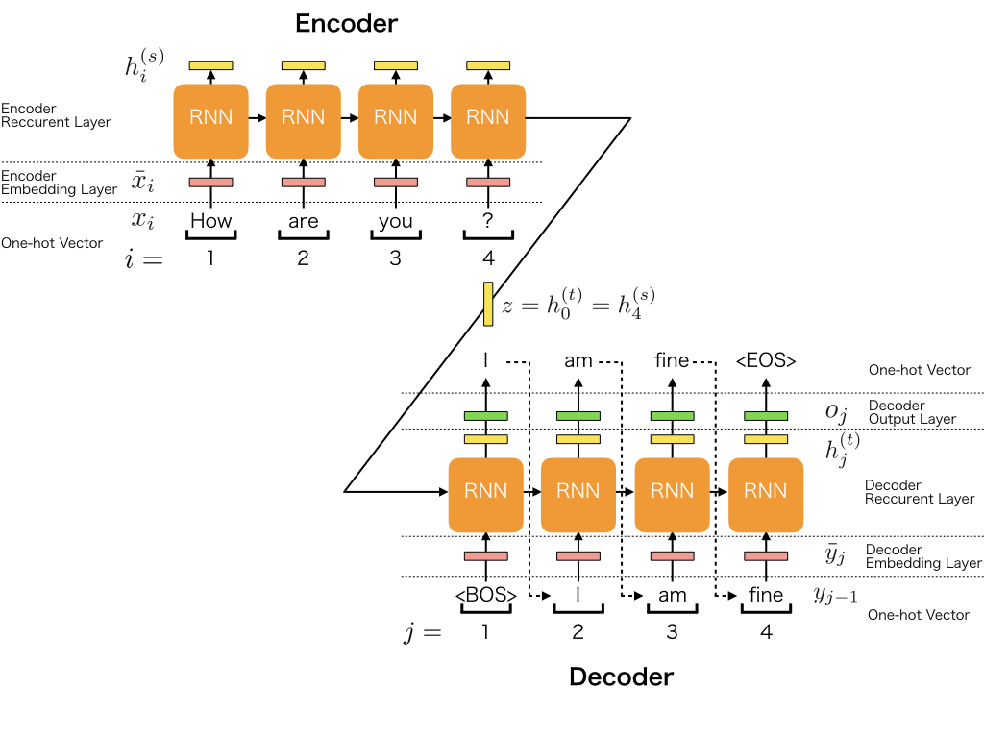
Encoder-Decoder example #1
https://docs.chainer.org/en/v7.8.0/examples/seq2seq.html

Slide 9
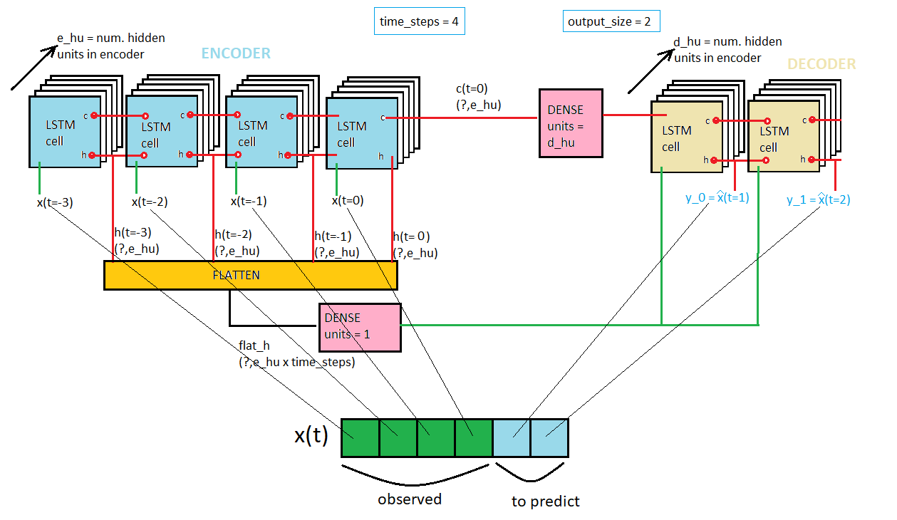
Encoder-Decoder example #2
https://datascience.stackexchange.com/questions/42499/does-this-encoder-decoder-lstm-make-sense-for-time-series-sequence-to-sequence

Slide 10
Encoder-Decoder example #3
https://datascience.stackexchange.com/questions/42499/does-this-encoder-decoder-lstm-make-sense-for-time-series-sequence-to-sequence

Slide 11
Attention mechanism (aditive variant)
Improves modelling for long-term dependencies
Can be broadly interpreted as a vector of importance weights
Utilizes all intermediate encoder states as follows:
Score is computed for each encoder state using a feed forward NN
Trained to identify relevant encoder states for every output word, generates
high score for the states for which attention is to be paid
low scores for the states which should be ignored
Each input to the network is formed by the given encoder state + actual decoder state!
Softmax is applied on these scores to produce the attention weights
All the weights lie between 0 and 1
All the weights sum to 1
Context vector is computed as a weighted sum using the encoder states and correspodings weights
This vector and the last output words forms a new input to the decoder
https://lilianweng.github.io/posts/2018-06-24-attention/

Slide 12
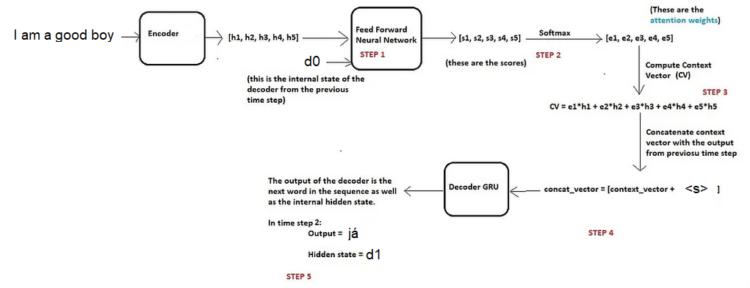
Attention mechanism example: step 1
https://towardsdatascience.com/intuitive-understanding-of-attention-mechanism-in-deep-learning-6c9482aecf4f

Slide 13
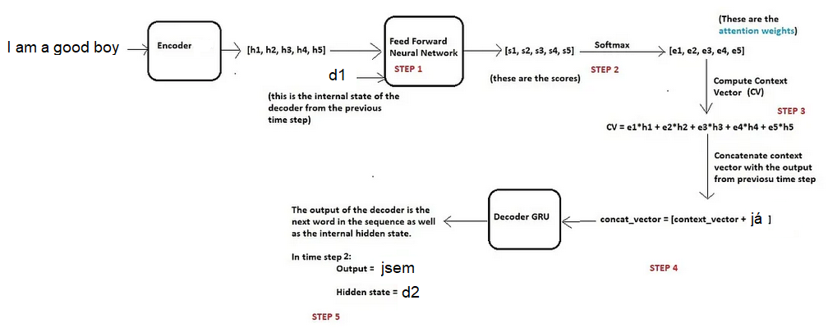
Attention mechanism example: step 2
https://towardsdatascience.com/intuitive-understanding-of-attention-mechanism-in-deep-learning-6c9482aecf4f

Slide 14
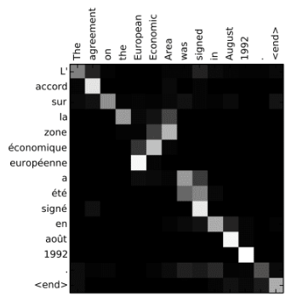
Attention mechanism
Attentional Interpretation of French to English Translation: Taken from Dzmitry Bahdanau, et al., Neural machine translation by jointly learning to align and translate, 2015
Animation:
https://ai.googleblog.com/2016/09/a-neural-network-for-machine.html

Slide 15
Transformer model
Proposed by Google in 2017 (more than 70K citations up to 2023!!)
Ashish Vaswani, Noam Shazeer, Niki Parmar, Jakob Uszkoreit, Llion Jones, Aidan N. Gomez, Łukasz Kaiser, and Illia Polosukhin. 2017. Attention is all you need. In Proceedings of the 31st International Conference on Neural Information Processing Systems (NIPS'17). Curran Associates Inc., Red Hook, NY, USA, 6000–6010.
State of the art model in NLP task
Utilizes attention mechanisms but, unlike RNNs, does not have a recurrent structure
Better parallelization, better modelling of long term dependencies
With enough training data, attention mechanisms alone can match the performance of RNNs with attention

Slide 16
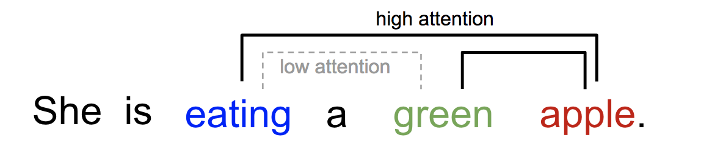
Self-attention (intra attention) mechanism
Allows to relate different words of a single sequence to compute a representation of the same sequence
The attention vector determines how strongly is each word correlated with (or “attends to”) other words (elements)
Every word in the sequence is approximated by the sum of values of other words weighted by the corresponding attention vector

Slide 17
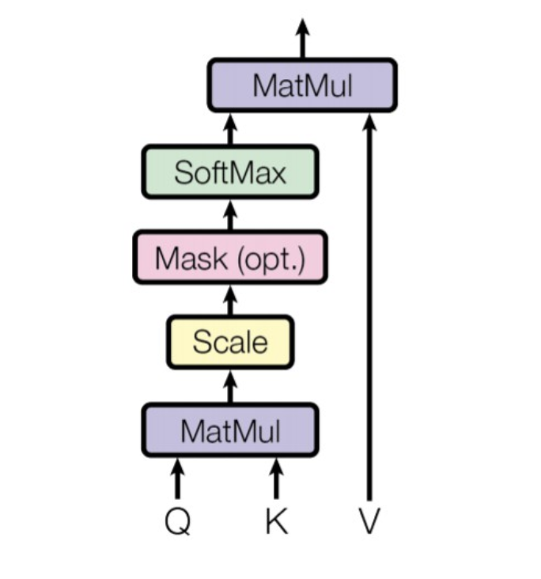
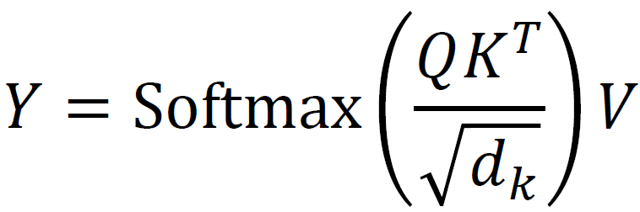
Self-attention (intra attention) block
The input is formed by N words (tokens)
each word is represented by an embedding vector x_{n}
Has three matrices of weights:
W_{q}, W_{k} and W_{v}
These are trained to compute hidden represention of each word: vectors qn,tn,vn
These vectors form together matrices Q,K,V
The output sequence Y is calculated as:

Slide 18
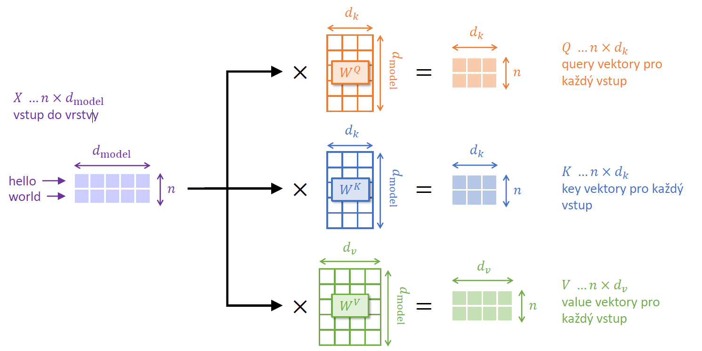
Self-attention (intra attention)

Slide 19
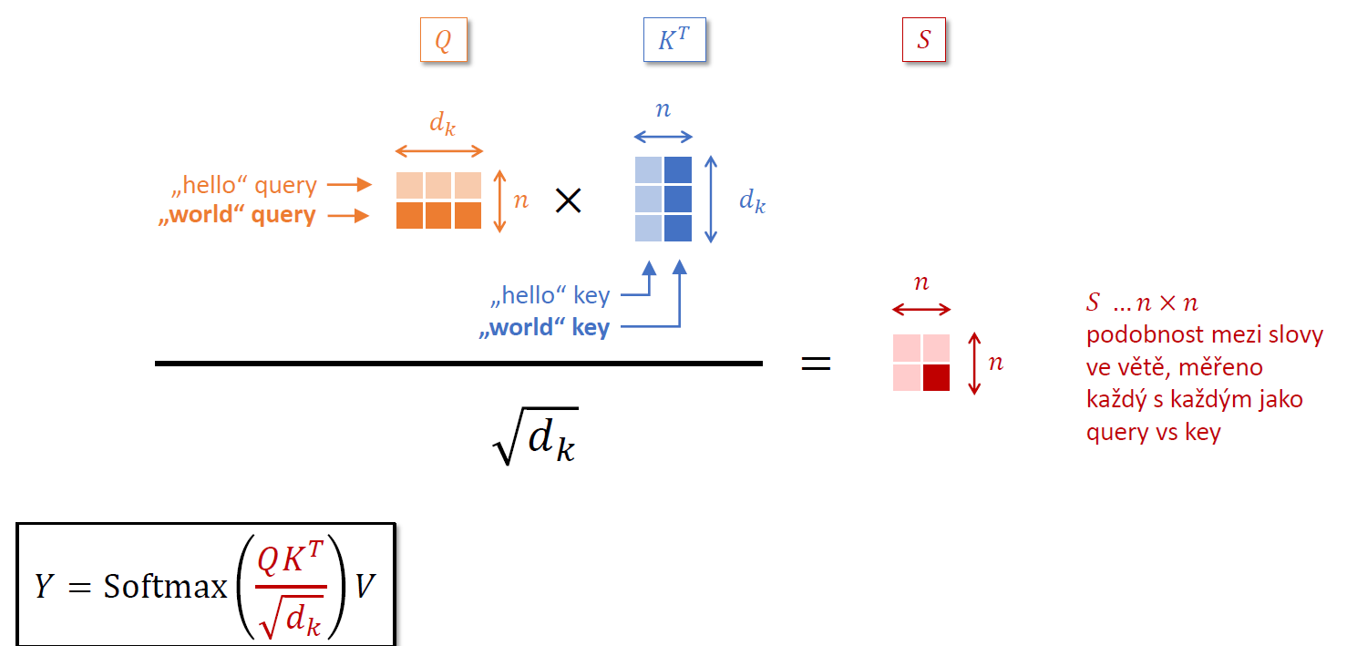
Self-attention (intra attention)

Slide 20
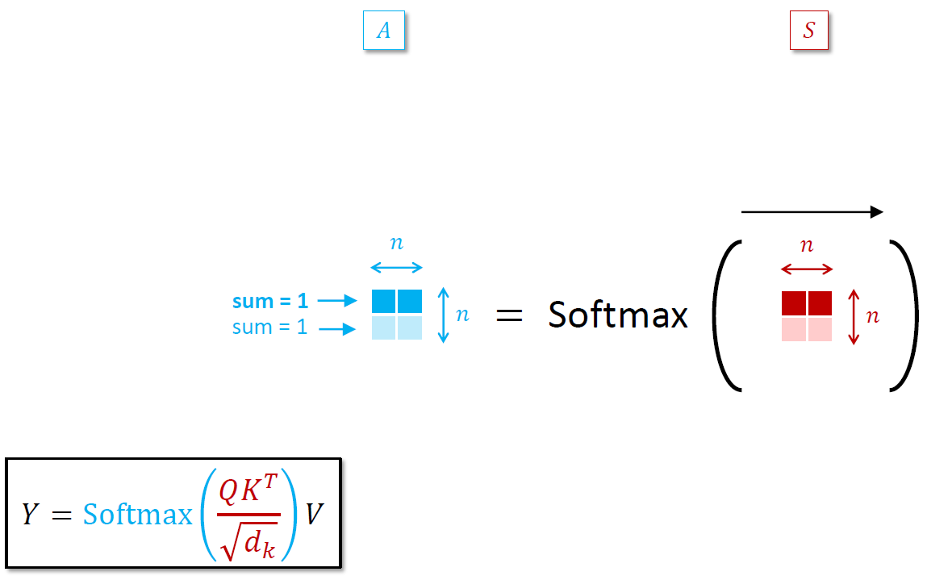
Self-attention (intra attention)

Slide 21
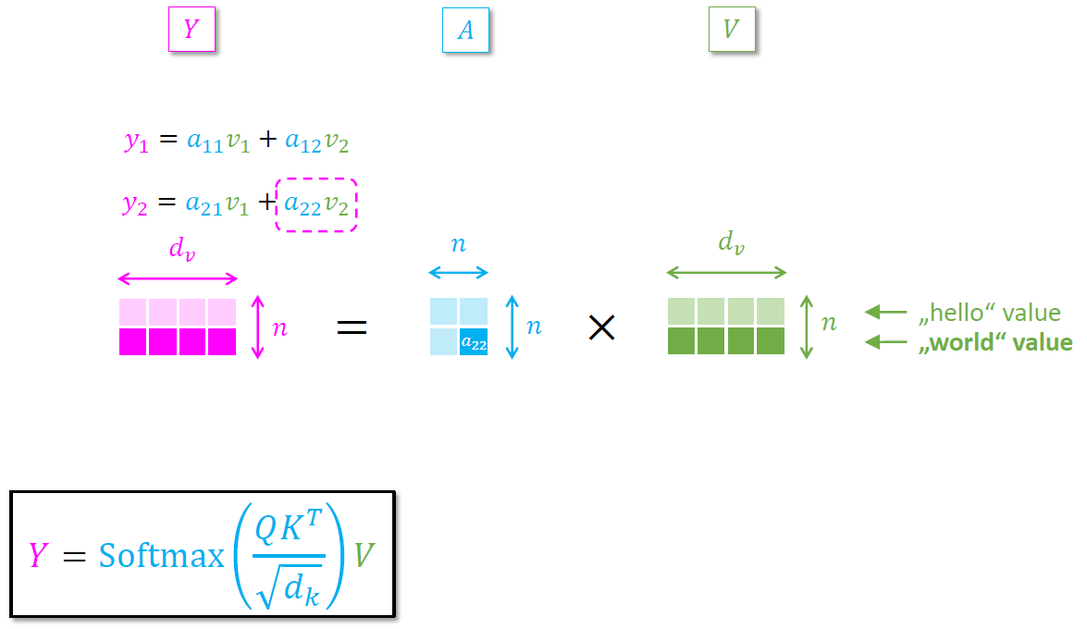
Self-attention (intra attention)

Slide 22
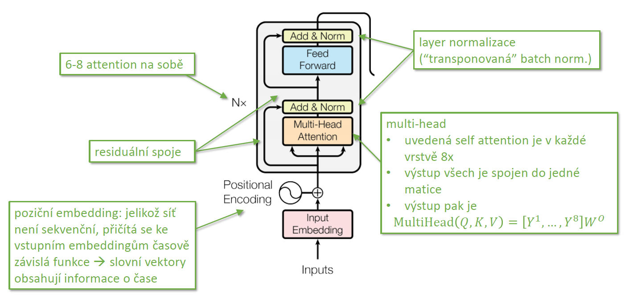
Transformer: encoder

Slide 23
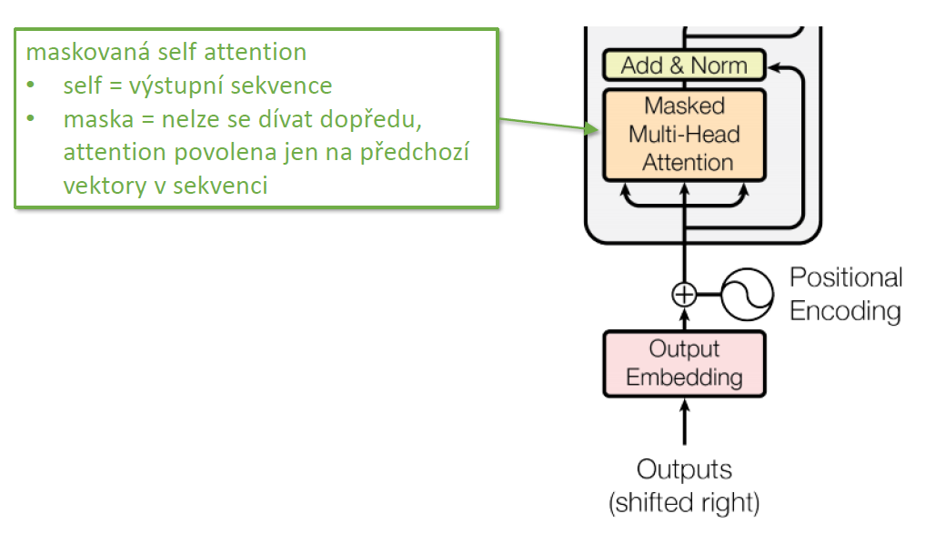
Transformer: decoder

Slide 24
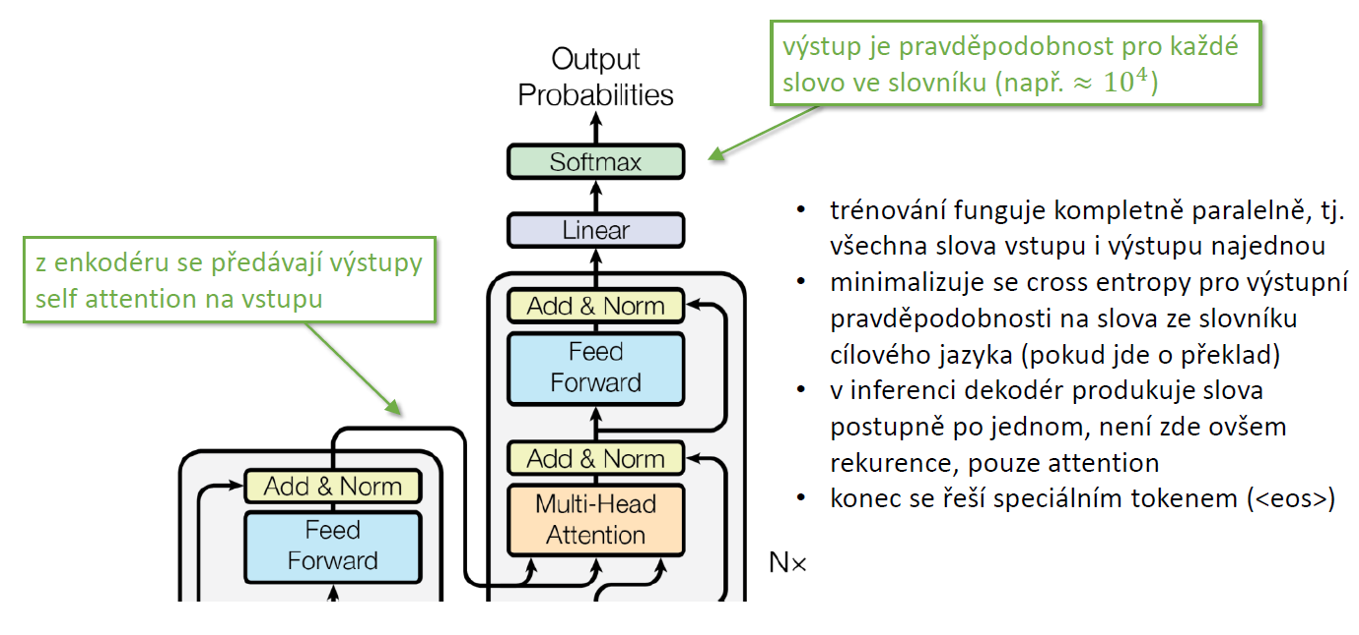
Transformer: encoder-decoder

Slide 25
Transformed-based LMs
BERT (Google)
Transformer encoder+decoder
Used for extraction of contextualized word vectors
GPT (OpenAI)
Utilizes only decoder
Can be fine-tuned for many tasks:
Sentiment analysis
Text clasification

Slide 26
Applications of LMs
Machine translate
Google translate
DeepL
GitHUB Copilot
GrammarlyGO
Grammarly's on-demand, contextually aware assistant powered
ChatGPT

Slide 27
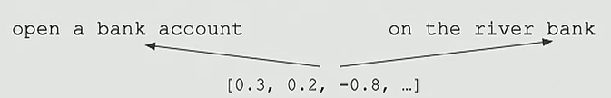

NN-based LMs versus word embeddings
Word embedding (Word2Vec)
Is given by context words in the training corpus
When applied to text, the vector for a given word is the same regardless of its context (or meaning)
Language model
Words are represented in a given sequence depending on their context (and therefore meaning)

Slide 28
GPT-based models

Slide 29
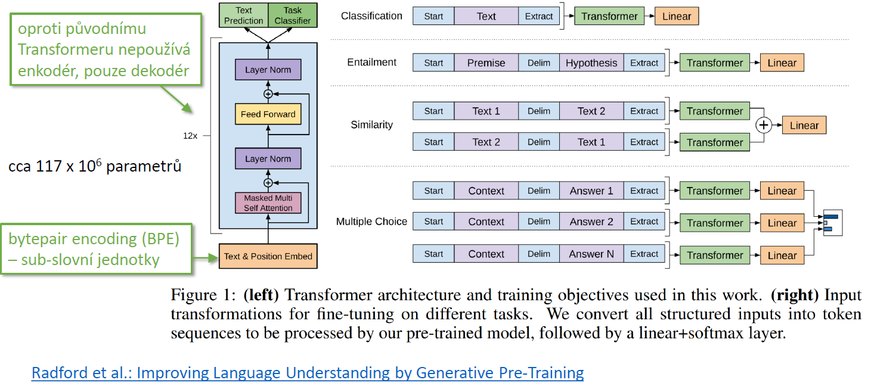
GPT model architecture

Slide 30
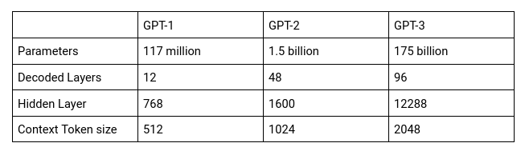
Existing types of large GPT models
GPT-4 (2023)
100T parameters
Context token size: 8192 (up to 32768)

Slide 31
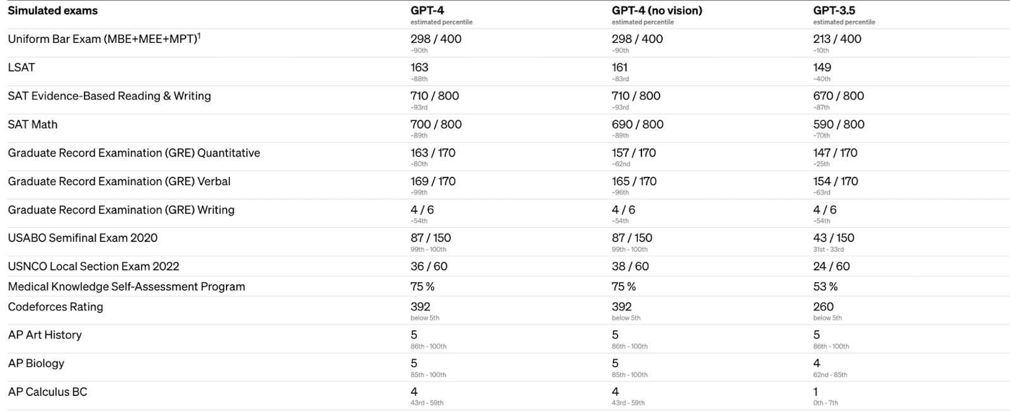
GPT-4 vs GPT-3 performance
GPT-4 improves GPT -3's factual correctness, scoring 40% higher on OpenAI's internal factual performance benchmark and producing fewer "hallucinations" or factual errors.

Slide 32
ChatGPT

Slide 33
Basic facts (based on GPT3-model)
chatbot developed by OpenAI and launched in November 2022
very large model (not all parameters are publicly available):
175B parameters => 800GB storage
Training must be parallelized over multiple GPUs
Training data: 45 TB
Training:
9 days using cloud cluster (Azure) with thousands of Tesla V100 GPUs
355 years on single V100 card
$1.4M ~ $12M
1287 MWh
Deployment:
With an average of 13 million unique visitors to ChatGPT in January 2023, the corresponding chip requirement is more than 30,000 Nvidia A100 GPUs, with an initial investment cost of about $800 million and a daily electricity cost of about $50,000.

Slide 34
Two stage training
Pre-training of a GPT model (decoder-only transformer)
The objective function is to predict future words given an input sentence
The data used is crawled from the internet
3-phase fine-tuning (to create a question-answering chat model):
fine-tuning on data containing questions and answers
the model takes a question as input and learns to generate an answer
training a reward model on another data containing questions with several corresponding answers
this model rank can rank answers from most relevant to least relevant
reinforcement learning to fine-tune the model to improve the accuracy of answers

Slide 35
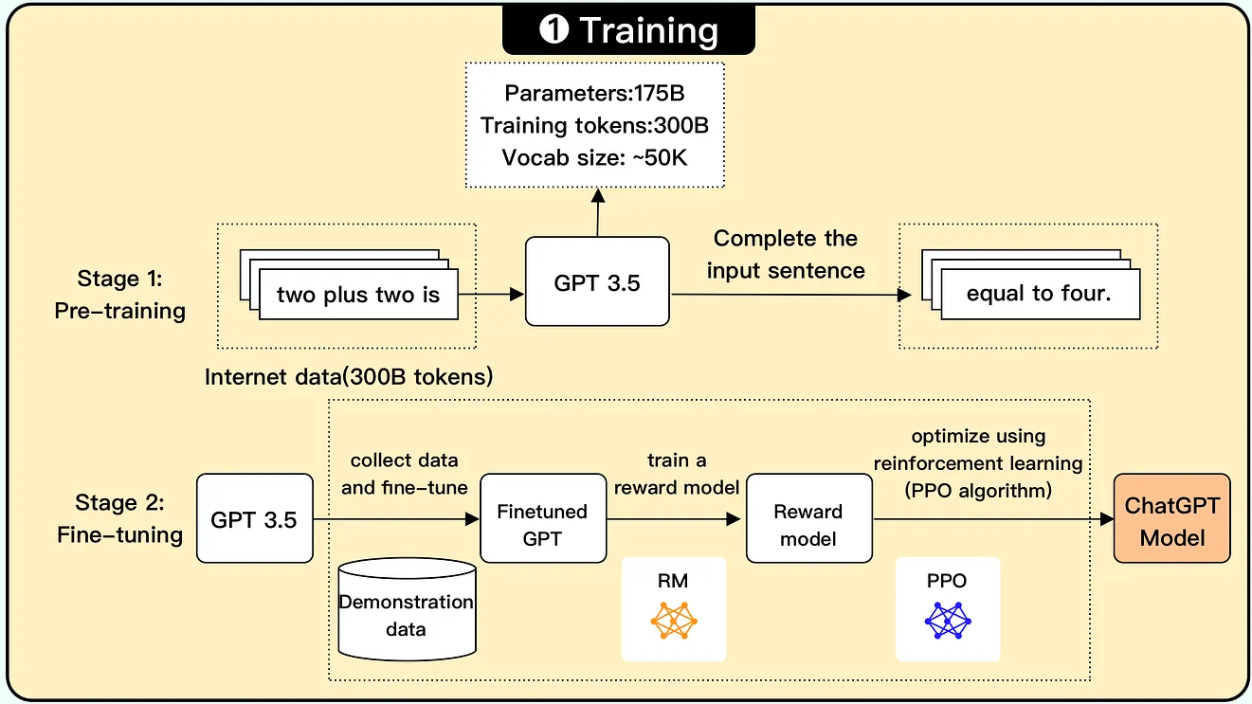
Training scheme
https://blog.bytebytego.com/p/ep-44-how-does-chatgpt-work

Slide 36
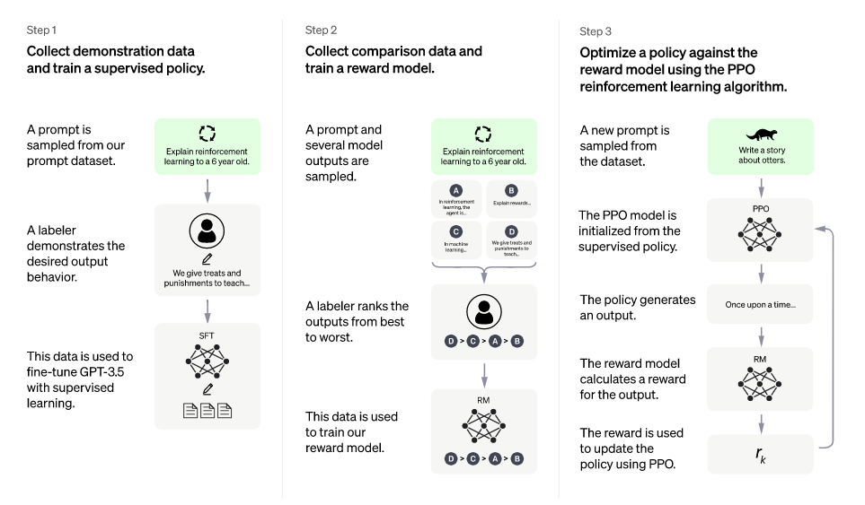
Fine-tuning diagram
https://openai.com/blog/chatgpt

Slide 37
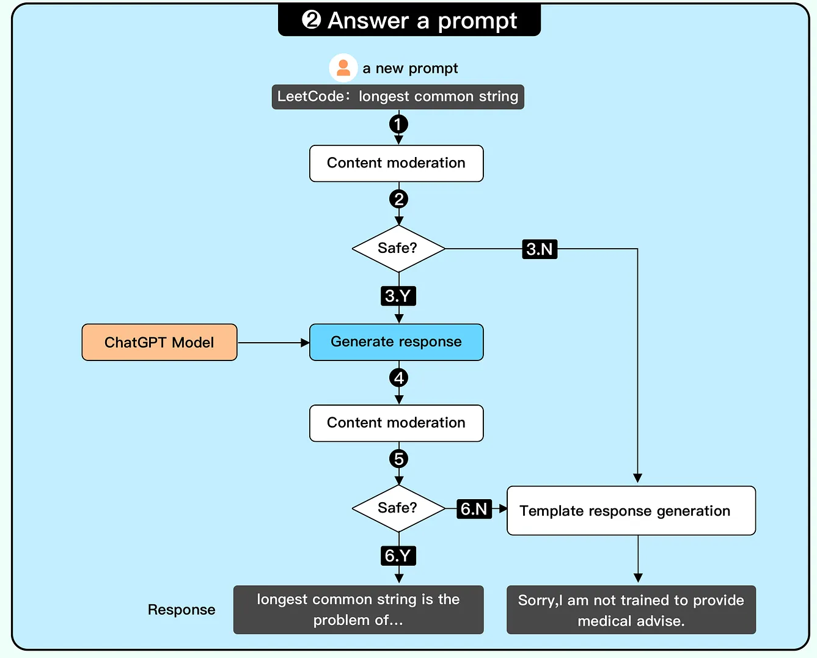
Deployment
https://blog.bytebytego.com/p/ep-44-how-does-chatgpt-work

Slide 38
ChatGPT-3 limitations (04/2023)
Can Provide Wrong Answers (hallucination)
The output is randomized
It is difficult to evaluate the results
ChatGPT Has Bias Baked Into Its System
Given by training data

Slide 39
Applications
Text summarization
Including ASR output
Text generation
General and marketing phrases, advertisements, …
Code generation
And many more …

Slide 40
Užitečné odkazy
https://towardsdatascience.com/nlp-101-word2vec-skip-gram-and-cbow-93512ee24314
Stanford University, kurz cs 224n
http://web.stanford.edu/class/cs224n/
Youtube

